Slide 1

Computer Networking (IT-3001)
KALINGA INSTITUTE OF INDUSTRIAL TECHNOLOGY
Deemed to be University, Bhubaneswar
School of Computer Engineering
4 Credit
Autumn-2018

Slide 2
Transportation vs. Computer Network
Transportation | Computer Network
Vehicles/People | Packets/Payload
Street address | IP address
Follow a route to destination | Routing Algorithm
Intersection | Bridge/router
Traffic jam | Network congestion
Stop and go traffic light | Flow control
Accident | Collision of packets

Slide 3
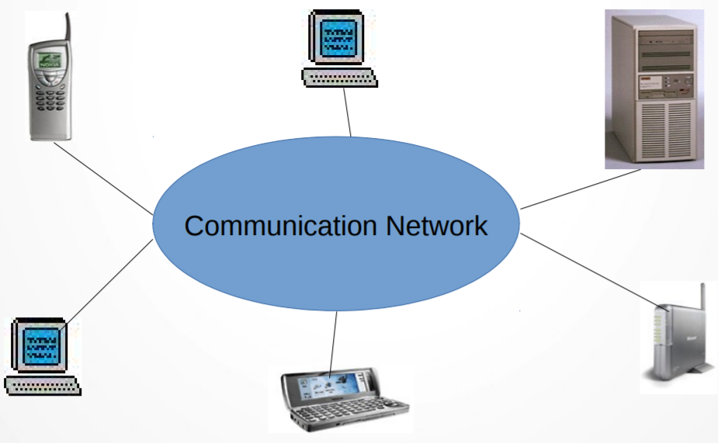
Requirements for Communication in Computer Networks
Communication: The exchange of thoughts, messages, or information, as by speech, signals, writing, or behavior.

Slide 4
Requirements for Communication..
HARDWARE
Communication end points (Hosts)
(Servers, Desktops, Laptops, Smart-phones etc.)
Network Interface card
(Hardware that connect a device to a network)
Communication Links
(Physical media that interconnects computing devicess. i.e. Co-axial cable,
fiber-optics, Twister-pair, Air (Wireless).
Switches / Gateways / Routers
(Interconnect Networks (which are made up of hosts and links))

Slide 5
Requirements for Communication..
SOFTWARE
Protocol
(Defines format and rules for exchange of messages)
- What to send: Format
- When to send & How to act : Rules

Slide 6
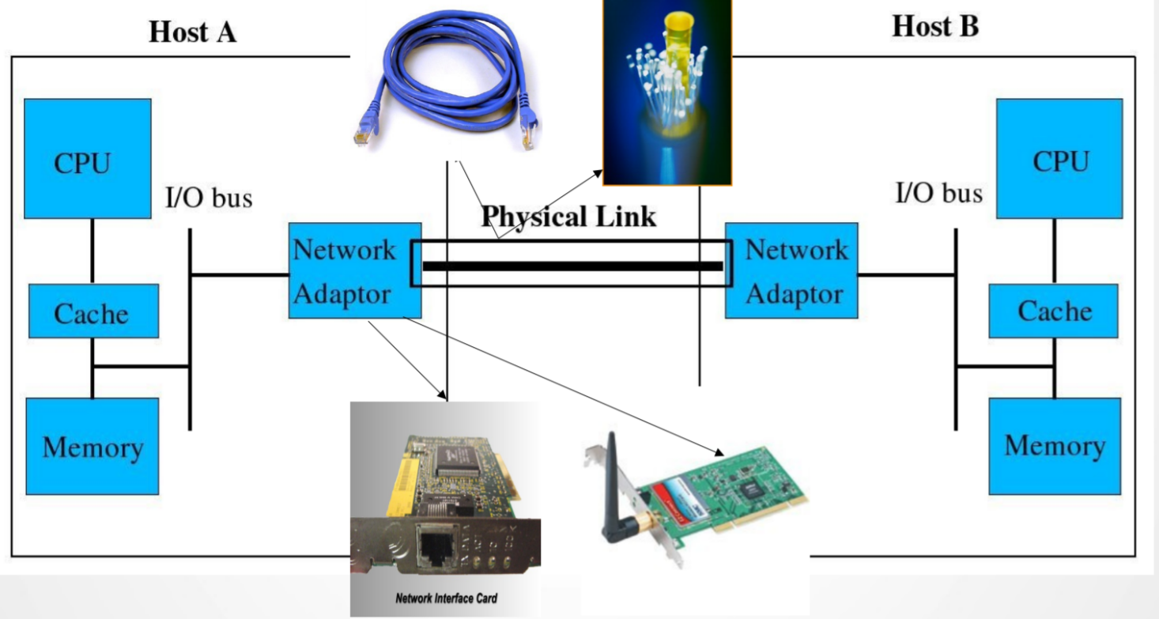
Requirements for Communication..
(Two computers talk to each other)

Slide 7
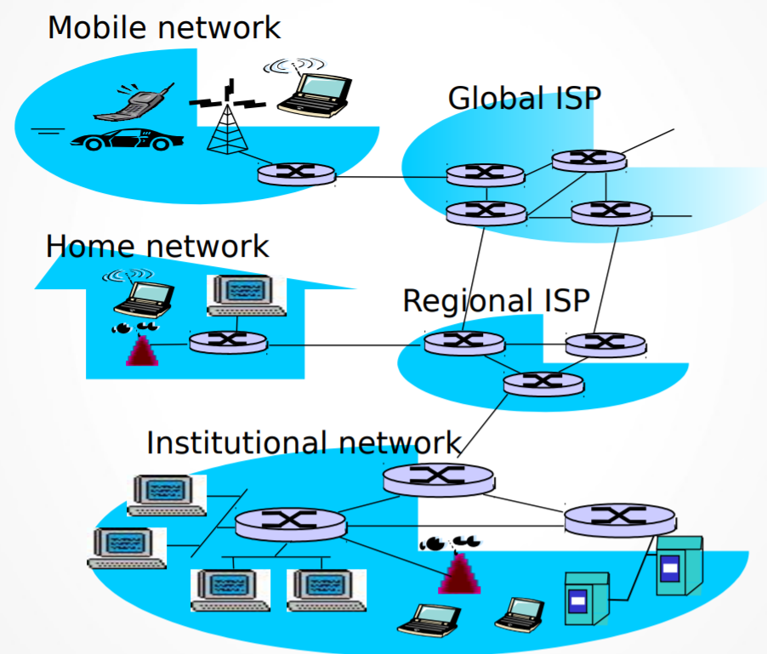
Requirements for Communication..
(Many computers talk to each other)

Slide 8
Goals of Computer Network
Enable Efficient, Robust and Scalable Communication
- Efficient in terms of delay, cost, energy etc
- Robust towards failures or errors
- Scalable with more users and data
Means
- Technology Development (Hardware): Faster/Cheaper/Energy-
efficient Routers, Links and Hosts
- Protocols (Software): Implement many of the required
functionality to support communication, Provide reliability, Route
packets, Share physical media etc, Each protocol tries to achieve a
specific goal

Slide 9
Goals of Computer Network...
Challenges
Tradeoff:
- Cost vs delay vs Energy
- Need to strike the right balance based on usage scenario
System Failure:
- Nodes can die
- Links corrupt packets
- Processing can duplicate or reorder packets
Backward compatibility:
- Newer versions of protocol should support older devices

Slide 10
Popular Metrics
Capture performance of protocols (determines whether goals are being met or not) Eg. Throughput, Latency, Energyconsumption.
Example:
- Throughput vs Number of Nodes in the system
- Throughput vs Energy consumption
- Loss Rate/Delay vs Number of Hops

Slide 11
Throughput Vs. Bandwidth
Bandwidth is the maximum amount of data that can move from one point to another over a given amount of time.
Throughput is the amount of data that actuality moves from one point to another over a given amount of time.
Transfer Throughput = Amount of data / Time to send data from source to destination
Receiving Throughput = Amount of data/Time it took to receive the data at destination (1st to last bit)

Slide 12
Throughput

Slide 13
Latency/Delay
Delay is a period of time before an event occurs; the act of delaying; lingering inactivity while latency is the state of being latent.
Latency is the delay, a period between the initiation of something and the occurrence.
Latency is the time that a data packet takes to travel from one point to another. Another accurate term for Latency is delay, the same as the one-way delay.

Slide 14
Latency/Delay
1.Suppose there is exactly one packet switch between a sending host and areceiving host. The transmission rates between the sending host and the switch and between the switch and the receiving host are R 1 and R 2 , respectively. Assuming that the switch uses store-and-forward packetswitching,what is the total end-to-end delay to send a packet of length L?(Ignore queuing, propagation delay, and processing delay.)

Slide 15
Latency/Delay
2.A packet of length 1,000 bytes to propagate over a link of distance 2,500 km, propagation speed 2.5 · 10^8 m/s, and transmission rate 2 Mbps? Calculate the transmission and Propagation delay. Does Propagation delay depend on packet length? Does this delay depend on transmission rate?(Ignore queuing and processing delay.)

Slide 16
Latency/Delay
3.Suppose Host A wants to send a large file to Host B. The path from Host A to Host B has three links, of rates R 1 = 500 kbps, R 2 = 2 Mbps, and R 3 = 1
Mbps.
a) Assuming no other traffic in the network, what is the throughput for the file transfer.
b) Suppose the file is 4 million bytes. How long will it take to transfer the file to Host B?(Ignore queuing, propagation delay, and processing delay.)

